Slide 1
PYTHON PROGRAMMING & DATA SCIENCE

Slide 2

Patterns
Pattern:
A pattern is some phenomenon that repeats regularly based on a set rule or condition.
(or)
A pattern represents a physical object or an abstract notion.
In generally , the pattern may represent physical objects like balls, animals or furniture.
Abstract notions could be like whether a person will play tennis or not(depending on features like weather etc.)
It gives the description of the object or the notion.
• The description is given in the form of attributes of the object.
• These are also called the features of the object.

Slide 3
Patterns
Example:
Imagine that we want to draw a series of cats.
All cats share common characteristics such as
Have eyes, tails and fur,
eating fish and make meowing sounds.
we can make a good attempt at drawing a cat, simply by including these common characteristics.
In computational thinking, these characteristics are known as patterns.
Once we know how to describe one cat we can describe others, simply by following this pattern.
The only things that are different are the specifics:
one cat may have green eyes, a long tail and black fur
another cat may have yellow eyes, a short tail and striped fur

Slide 4
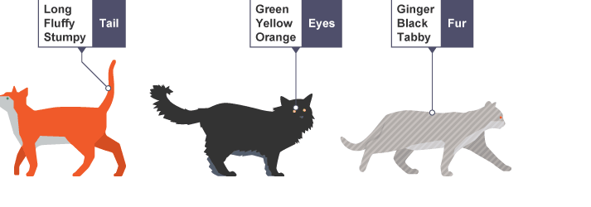
Patterns
Example:
Imagine that we want to draw a series of cats.

Slide 5
Patterns
Other examples are:
The colours on the clothes, speech pattern , …etc.
Pattern Recognition :
Pattern recognition is the process of recognizing patterns by using machine learning algorithm.
Pattern recognition can be defined as the classification of data based on knowledge already gained or on statistical information extracted from patterns and/or their representation.
One of the important aspects of the pattern recognition is its application potential.
Pattern recognition is the scientific discipline that allows us to classify objects into several categories or classes that can be further used to perform analysis and improve certain things.

Slide 6
Patterns
The three best-known approaches for pattern recognition are:
1) Template matching
2) Statistical classification
3) Syntactic or structural matching
1) Template matching-
Template Matching is used to determine the similarity between two entities (points, curves, or shapes) of the same type.
The pattern to be recognized is matched with a stored template along with geometrical transformations.
This approach has some obvious disadvantages of being too rigid and having the need for lots of templates.

Slide 7
Patterns
2) Statistical classification–
In this method, each pattern is represented in terms of some features or measurements.
The main objective of this approach is to establish decision boundaries in the feature space. This separates patterns belonging to different classes creating some rules for an inter-class boundary.
3) Syntactic or structural matching–
This method works on a hierarchy framework where a pattern is said to be composed of simple sub-patterns that are themselves built from yet simpler sub-patterns.

Slide 8
Patterns
STEPS INVOLVED IN PATTERN RECOGNITION
The major steps involved in a typical pattern recognition process are-
Collection of relevant data from various sources
Pre-processing of data – It involves removing noise from data and making data in a format suitable for applying algorithms.
Examining data and Dividing into classes
Analyzing of various classes and its boundaries
Applying these analyses according to the needs.

Slide 9
Patterns
In a typical pattern recognition application, the raw data is processed and converted into a form that is amenable for a machine to use.
Pattern recognition involves classification and cluster of patterns.
In classification, an appropriate class label is assigned to a pattern based on an abstraction that is generated using a set of training patterns or domain knowledge.
Classification is used in supervised learning.
Clustering generated a partition of the data which helps decision making, the specific decision making activity of interest to us.
Clustering is used in an unsupervised learning.

Slide 10
Patterns
Features may be represented as continuous, discrete or discrete binary variables. A feature is a function of one or more measurements, computed so that it quantifies some significant characteristics of the object. Example:
consider our face then eyes, ears, nose etc are features of the face.
Pattern recognition possesses the following features:
Pattern recognition system should recognise familiar pattern quickly and accurate
Recognize and classify unfamiliar objects
Accurately recognize shapes and objects from different angles
Identify patterns and objects even when partly hidden
Recognise patterns quickly with ease, and with automaticity.

Slide 11
Patterns
Patterns in Machine Learning
Machine learning uses mathematics, statistics, and domain-specific knowledge and data to solve complex problems.
Machine Learning:
Machine learning is turning things(data) into numbers and finding patterns in those numbers.
For finding patterns, algorithms are used. An algorithm is a specific set of steps to perform a task.
An “algorithm” in machine learning is a procedure that is run on data to create a machine learning “model.”
A machine learning algorithm is written to derive the model.
The model identifies the patterns in data that fit the dataset. Fit is a synonym to “find patterns in data”.

Slide 12
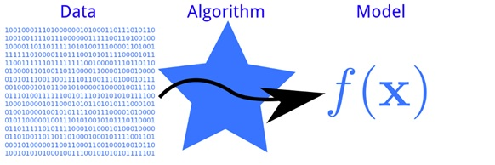
Patterns
Patterns in Machine Learning
A “model” in machine learning is the output of a machine learning algorithm run on data.
A model represents what was learned by a machine learning algorithm. It is basically a mathematical function that can adapt to new data by tweaking its parameters.

Slide 13
Patterns
Patterns in Machine Learning
Models are like the general equation of a line y = a + bx, while patterns are like a specific equation, e.g. y = 5 + 2x.
Machine learning is about generalizing correctly to brand-new situations.
The basic task of machine learning is to create a model that can predict or classify different patterns from data.
One of the applications of this is the classification of spam or non-spam data.
The algorithms adaptively improve their performance as the number of samples available for learning increases.
Two main types of machine learning are supervised and unsupervised machine learning.

Slide 14
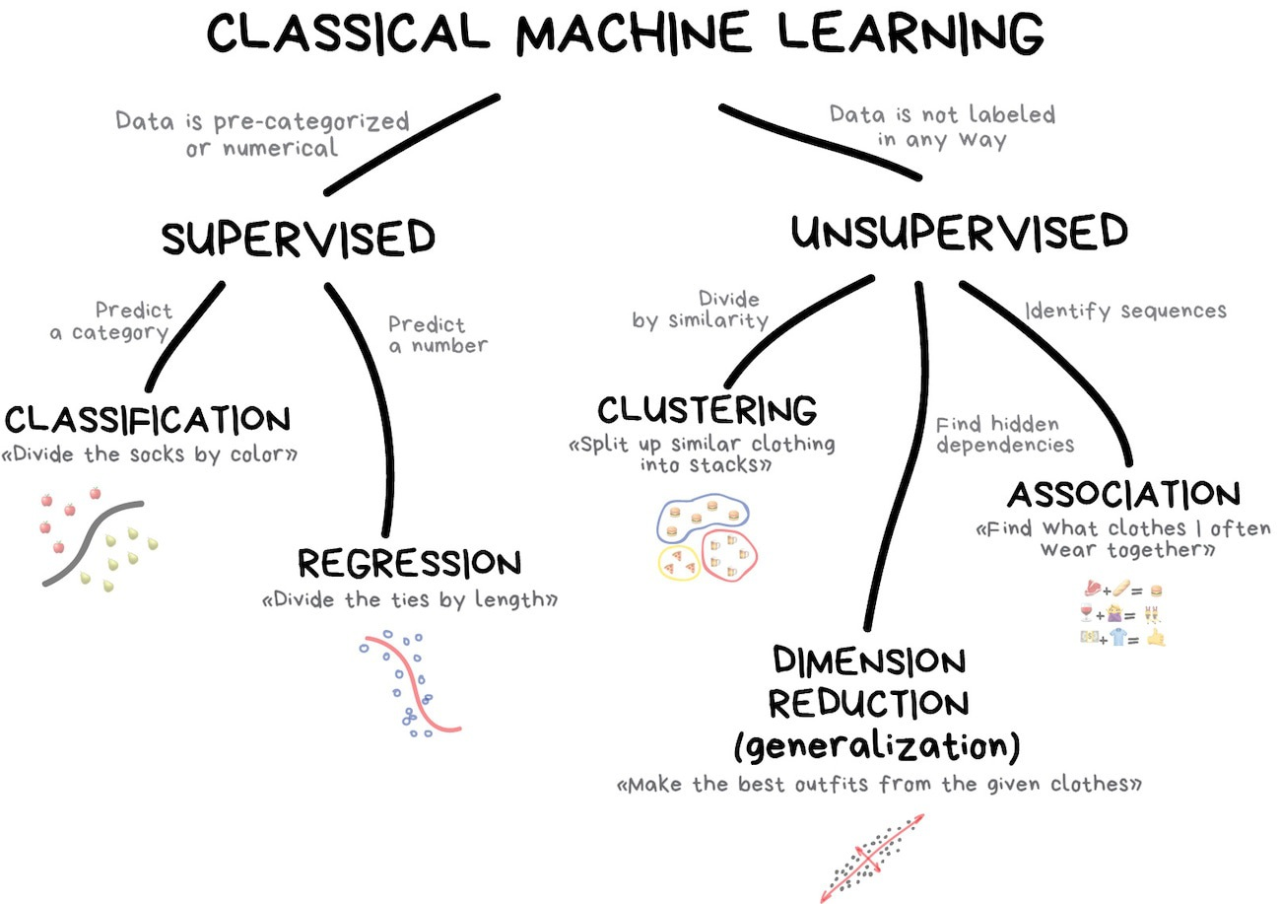
Patterns

Slide 15
Patterns
Patterns in Machine Learning
Pattern recognition in a supervised approach is called classification.
These algorithms use a two-stage methodology for identifying the patterns.
The first stage is the development/construction of the model and the second stage involves the prediction for new or unseen objects.
Unsupervised learning is a type of machine learning that looks for previously undetected patterns in a data set with no pre-existing labels and with minimum human supervision.
Classification is supervised learning, while clustering is unsupervised learning.

Slide 16
Patterns
Representation of patterns
Patterns can be represented mainly in 4 different ways. Those are:
Representing patterns as vectors
Representing patterns as strings
Representing patterns by using logical operators
Representing patterns using fuzzy and rough sets

Slide 17
Patterns
Representing patterns as vectors
The most popular method of representing patterns is as vectors.
Here, the training dataset may be represented as a matrix of size (nxd).
where each row corresponds to a pattern and each column represents
a feature.
Each attribute/feature/variable is associated with a domain.
A domain is a set of numbers, each number pertains to a value of an attribute for that particular pattern.
The class label is a dependent attribute which depends on the ‘d’ in-dependent attributes.

Slide 18
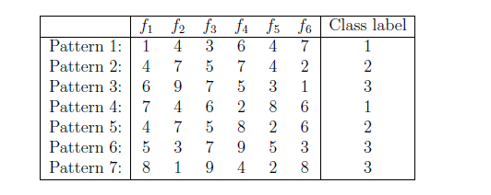
Patterns
Example:
The dataset could be as follows :
In this case, n=7 and d=6.
Each pattern has six attributes(or features).
Each attribute in this case is a number between 1 and 9.
The last number in each line gives the class of the pattern.
In this case, the class of the patterns is either 1, 2 or 3.

Slide 19
Patterns
If the patterns are two- or three-dimensional, they can be plotted.
Example:
Consider the dataset
Pattern 1 : (1,1.25,1) Pattern 2 : (1,1,1)
Pattern 3 : (1.5,0.75,1) Pattern 4 : (2,1,1)
Pattern 5 : (1,3,2) Pattern 6 : (1,4,2)
Pattern 7 : (1.5,3.5,2) Pattern 8 : (2,3,2)
Pattern 9 : (4,2,3) Pattern 10 : (4.5,1.5,3)
Pattern 11 : (5,1,3) Pattern 12 : (5,2,3)
Each triplet consists of feature 1, feature 2 and the class label. This is
shown in Figure as follows

Slide 20
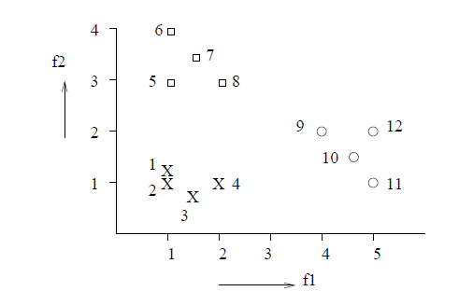
Patterns

Slide 21
Patterns
2. Representing patterns as strings
Here each pattern is a string of characters from an alphabet.
This is generally used to represent gene expressions.
For example, DNA can be represented as
GTGCATCTGACTCCT...
RNA is expressed as
GUGCAUCUGACUCCU....
This can be translated into protein which would be of the form
VHLTPEEK ....
Each string of characters represents a pattern.
Operations like pattern matching or finding the similarity between strings are carried out with these patterns.

Slide 22
Patterns
3. Representing patterns by using logical operators
Here each pattern is represented by a sentence(well formed formula) in
a logic.
Example1:
if (beak(x) = red) and (colour(x) = green) then parrot(x)
This is a rule where the antecedent is a conjunction of primitives and
the consequent is the class label.
Example2:
if (has-trunk(x)) and (colour(x) = black) and (size(x) = large) then elephant(x)

Slide 23
Patterns
4. Representing patterns using fuzzy and rough sets
The features in a fuzzy pattern may consist of linguistic values, fuzzy
numbers and intervals.
For example, linguistic values can be like tall, medium, short for height
which is very subjective and can be modelled by fuzzy membership values.
A feature in the pattern maybe represented by an interval instead of a
single number. This would give a range in which that feature falls.
Example:
(3, small, 6.5, [1, 10])
The above example gives a pattern with 4 features.
The first feature is an integer and second feature as a linguistic value.
The third feature is a real value.
The 4th feature is in the form of an interval. In this case the feature falls within the range 1 to 10. This is also used when there are missing values.

Slide 24
Patterns
4. Representing patterns using fuzzy and rough sets
Rough sets are used to represent classes.
A class description will consist of an upper approximate set and a lower approximate set.
An element ‘y’ belongs to the lower approximation if the equivalence class
to which ‘y ‘ belongs is included in the set.
On the other hand ‘y’ belongs to the upper approximation of the set if its equivalence class has a non- empty intersection with the set.
The lower approximation consists of objects which are members of the set with full certainty.
The upper approximation consists of objects which may possibly belong to the set.
.

Slide 25
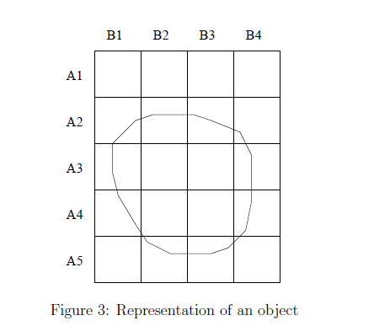
Patterns
Representing patterns using fuzzy and rough sets
For example, consider the Figure 3.
This represents an object whose location can be found by the grid shown.
The object shown completely covers (A3,B2), (A3,B3), (A4,B2) and (A4,B3).
The object falls partially in (A2,B1),(A2,B2),(A2,B3),(A2,B4),(A3,B1),(A3,B4),(A4,B1),(A4,B4),(A5,B2), and (A5,B3).

Slide 26
Patterns
Representing patterns using fuzzy and rough sets
The pattern can be represented as a rough set where the first four values of the grid gives the lower approximation and the rest of the values of the grid listed above form the upper approximation.
The classes can also be fuzzy. One example of this would be to have
linguistic values for classes. The classes for a set of patterns can be
small and big. These classes are fuzzy in nature as the perception of
small and big is different for different people.

